Slide 1


PROFESSIONAL ETHICS
BANGALORE INSTITUTE OF TECHNOLOGY
DEPARTMENT OF INFORMATION SCIENCE AND ENGINEERING
S MERCY
ASST. PROFESSOR
INFORMATION SCIENCE AND ENGINEERING
SHARMILA DHANANJAY POOJARY -1BI20IS085
POOJA HARIHAR -1BI20IS061

Slide 2
OBJECTIVES:
To explain the meaning of ethics
To discuss how ethics is different from professional ethics
To explain the role of ethics in the different professionals of human conduct

Slide 3
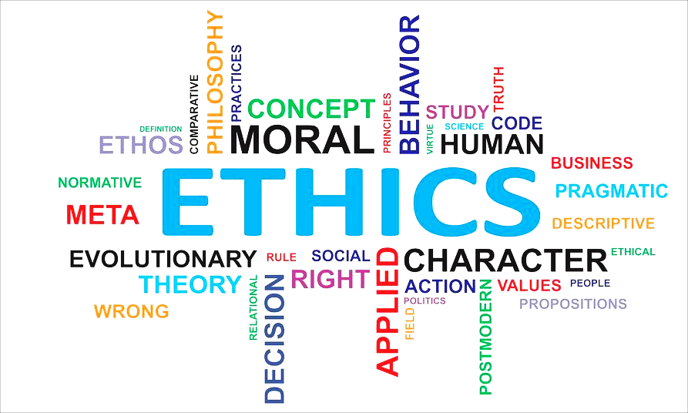

Slide 4
INTRODUCTION
Ethics is a branch of philosophy that addresses the concepts of right and wrong or good and evil. Ethics can also be called moral philosophy. Morality means usually a more practical approach to ethics, for example questions about the right and wrong in actions.
Professional ethics provides us means to solve certain ethical problems related to a certain profession.Thus, professional ethics cannot be only about abiding by the rules, but constant awareness to the rights and needs of the clients, and critical thinking in the cross-fire of ethics, rules, conventions and difficulties of social interaction.

Slide 5
Ethics is knowing the difference between what you have a right to do and what is right to do.
-Potter Stewart
Notes:
“Developing a good work ethic is key. Apply yourself at whatever you do, whether you’re a janitor or taking your first summer job because that work ethic will be reflected in everything you do in life.”

Slide 6
Scope of Ethics
The scope of ethics includes its own subject-matter. Ethics is a normative science that deals with moral ideals or good in the nature of our conduct. As a science of morality it does not enquire into the origin of human conduct but emphasizes on the contents and various problems of moral consciousness like motives, intentions, voluntary actions and so on.
The Scope of Ethics is wide which is mainly concerned with the principles or causes of action as : - What obligation is common to all ?
- What is good in all good acts?
- The sense of duty and responsibility.
- Individual and Society.

Slide 7
TYPES OF ETHICS:
1.Business ethics
2.Corporate ethics
3.Personal ethics

Slide 8
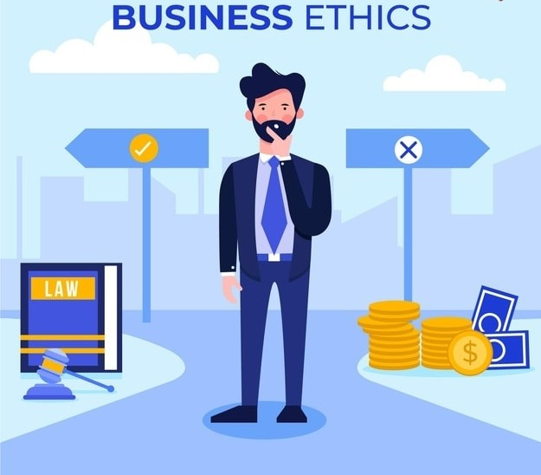
BUSINESS ETHICS
Business ethics is form of applied ethics that examines the ethical principles and moral.
It must be applied to all aspects of business conduct and relevant to the conduct of individuals and entire organizations.

Slide 9
NEED FOR BUSINESS ETHICS
Stop malpractices
Improve consumer confidence.
Survival of business.
Protect consumer rights.
Healthy competition.
Consumer movement.
Protecting employees and shareholders.

Slide 10
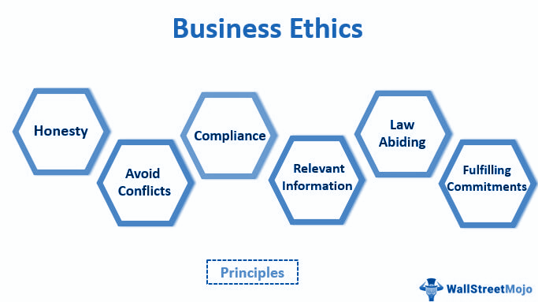
PRINCIPLES OF BUSINESS ETHICS
Honesty
Integrity
Trustworthiness
Loyalty
Fairness
Law abiding
Leadership
Accountability
Reputation
Morality

Slide 11
FACTORS AFFECTING BUSINESS ETHICS
Corporate culture
Performance
Environment
Leadership
Individual characteristic
External Stakeholder perception
Internal culture
Care of all stakeholder
Building ethical standard in business
Business vision
Functional strategy
Code of ethics
Code of conduct
Social responsible
Ethical culture
Ethical attitude
Leader as a
Teacher
Steward
Fair
No discrimination
No politics
Build trust
Concern to society

Slide 12
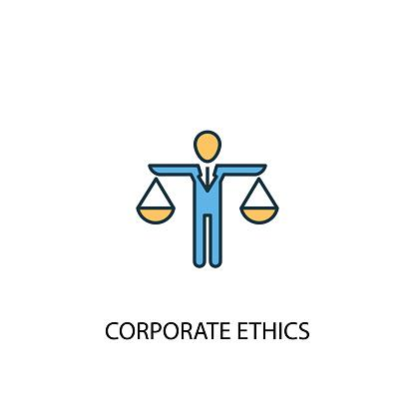
CORPORATE ETHICS
Corporate ethic is an element of business ethics. Corporate ethics is narrowly about a company’s SOCIAL obligations, which includes to the society in general. Corporate ethics is more about integrating economic, social and environmental targets in one strategy.

Slide 13
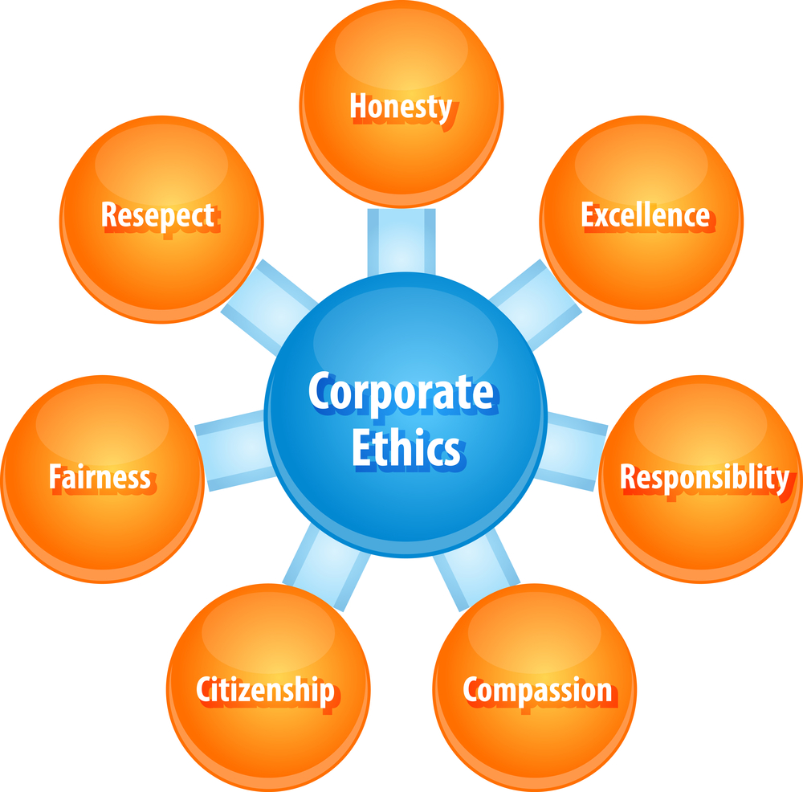
PRINCIPLES OF CORPORATE ETHICS
Always help others
Be honest
Respect others
Be loyal hardworking
Do right and follow right
Follow rules and policies

Slide 14
DIFFERENCE BETWEEN BUSINESS ETHICS AND CORPORATE ETHICS
BUSINESS ETHICS
CORPORATE ETHICS
The whole encompassing behaviour of business
Business ethics is very broad field of study concerning good ethical decision making in commercial contents
Business ethics is more about “good” or “bad” conduct according to moral standard
Corporate ethic is an element of business ethics
Corporate ethics is narrowly about a company’s SOCIAL obligations, which includes to the society in general.
Corporate ethics is more about integrating economic, social and environmental targets in one strategy.

Slide 15

PERSONAL ETHICS
Personal ethics is a category of philosophy that determines what an individual believes about morality and what is right and wrong.This is usually distinguished from business or legal ethics.
Personal ethics are the basic principles and
values that govern interactions among
individuals.
“You are personally responsible for becoming
more ethical than the society you grew up in”
-Eliezer Yudkowsky

Slide 16
FACTORS INFLUENCING PERSONAL ETHICS
Peer
Friends
Family
Personal
ethics
Religion
Situation
Media
Society

Slide 17
DIFFERENCE BETWEEN BUSINESS ETHICS AND PERSONAL ETHICS
BUSINESS ETHICS
PERSONAL ETHICS
1.Business ethics refers to an individual's values within their work environment and how they conduct themselves professionally.
1.Personal ethics refers to a person's
morals or values in any aspect of life.
2.Learned relatively later in life, specially after joining work.
2.Learned from childhood; influenced
by family, religion, friends and close
surroundings.
3.Examples include punctuality, time
management, confidentiality and
transparency.
3.Examples include honesty, openness,
integrity, sincerity, etc.

Slide 18
QUIZ
1)One of the characteristics of profession is
a)It gives scope to exercise one’s skill.
b)It gives monopoly on service.
c)It provides opportunity to help the poor and needy.
d)It demands high standard of honesty.
2)________________is defined as a group of people working together to create a surplus.
a. Routline b. organisation
c. system d. military
3)Accepted principles of right or wrong governing the conduct of business people are called:
Choose one answer.
a. business values. b. business conduct.
c. business ethics. d. business principles

Slide 19
4)A __________ exists when employees focus on the changing needs of customers and other stakeholders and support initiatives to keep pace with these changes.
a. adaptive culture b. aligning culture
c. complying culture d. responsive culture
5)Professional ethics take account of :
a.personal character of engineers b.tempartment of engineers
c.religious mind of engineers d.social background of engineers
6)_______________ are the welfare principles enunciated by the wise people, based on their experience and wisdom
answer choices
a.Values b.Morals
c.Rules d.Ethics

Slide 20
7)Which legislation relates to the concept of business ethics?
a. Freedom of Information action b.Food act
c.Building regulations d. All of the above
8) A_____________is a set of principles that people hold themselves to or that are held by
organizations or groups.
a.code of ethics b.code of honor
c.ethical perspective d.persuasive tactic
9)Which of these is a factor that affects ethical and unethical behaviour?
a.Ethical dilemma b.Diversity
c.Teamwork d.Open communication

Slide 21
Thank you!

